Slide 1
Investors’ Presentation Q2-2022
From a growing bank to a Stronger Bank!

Slide 2
Disclaimer: This is not an investment advice. Investment in Bank Nizwa SAOG stocks is subject to market risk. Investors are advised to do proper due diligence before making any investment decisions.

Slide 3
Table of Contents
Islamic Banking Sector
Bank Nizwa Journey of Growth
Financial Performance
Strategy 2025
Business Overview
Outlook H2-2022

Slide 4
Islamic banking sector

Slide 5






Islamic Banking Market Share in GCC
GCC Islamic Banking Share reaches 25% of total banking assets
National Champion with Total Market share in Islamic Banking stands at 25%.
15%
35%
24%
27%
22%
17%
Source: EY + Fitch Report
Notes:
Read GDP estimates: PWC

Slide 6
Islamic Banking Sector in Oman
Islamic Financial services introduced in 2012
Two full-fledged Islamic banks, and five Islamic windows
The fastest growing Islamic banking market in the GCC
Market share stands at 17% as per CBO report

Slide 7
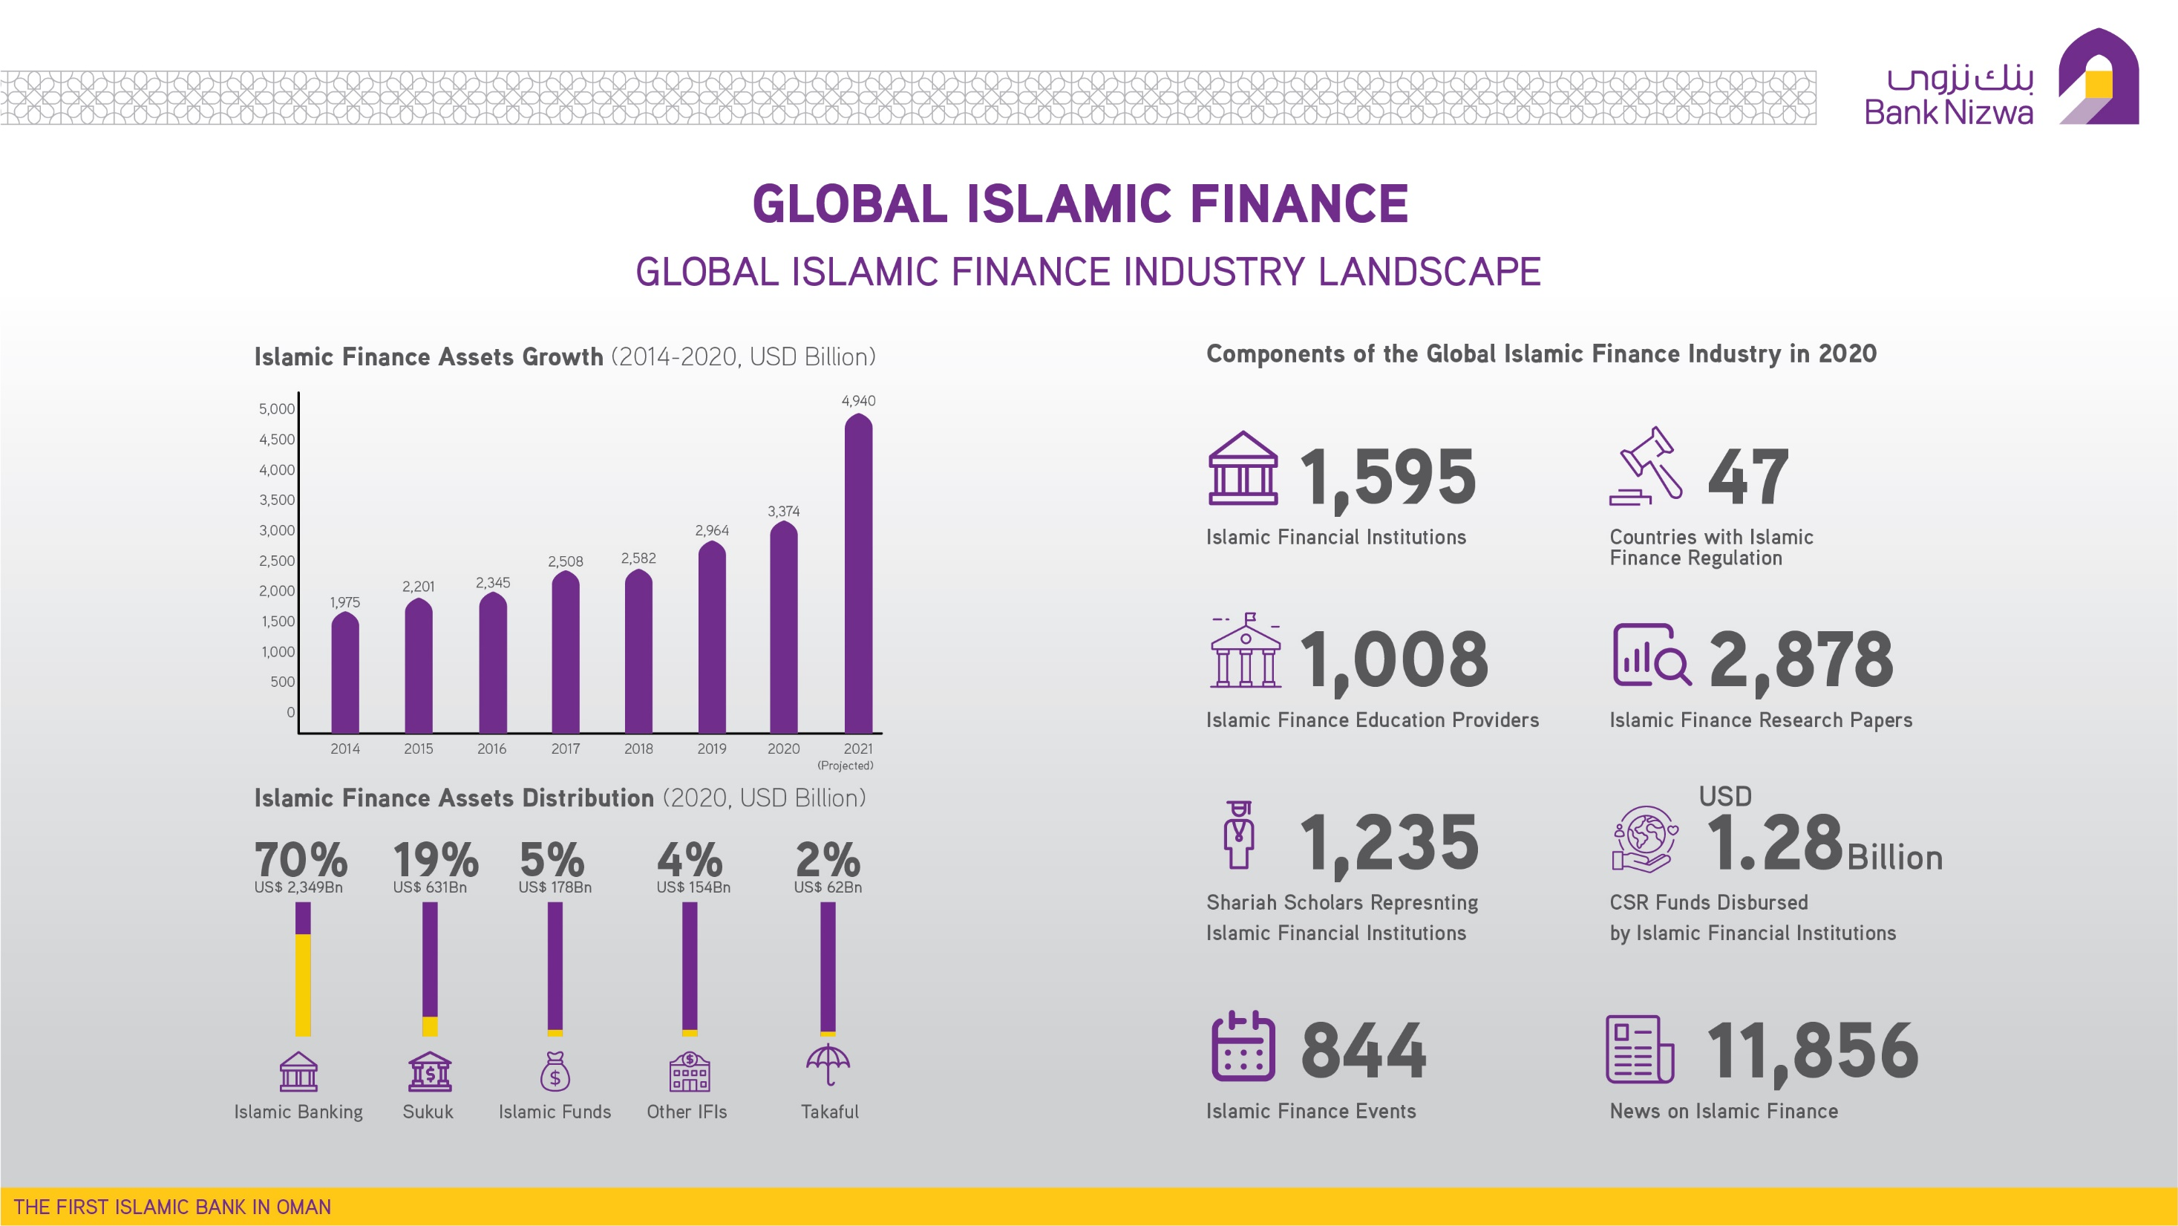
Global Islamic Finance Industry Landscape

Slide 8
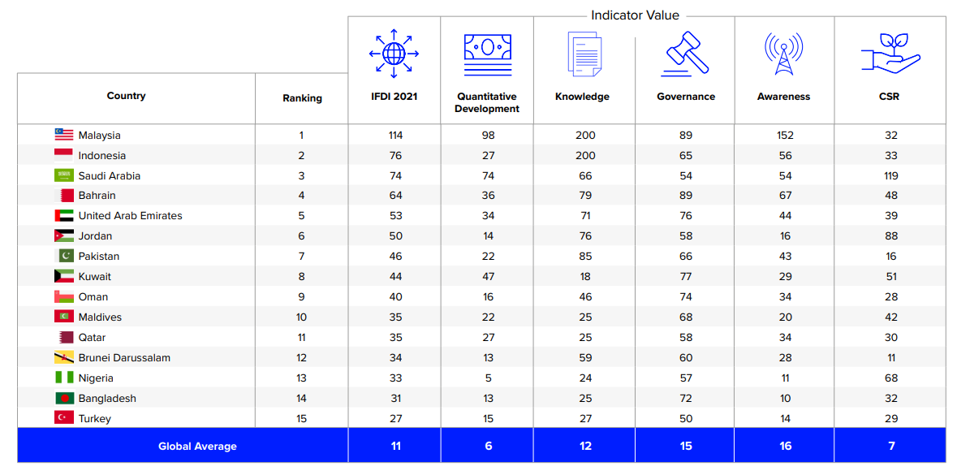
Oman Position in Islamic Finance Development Indicator (IFDI)

Slide 9
BANK NIZWA Journey of Growth

Slide 10
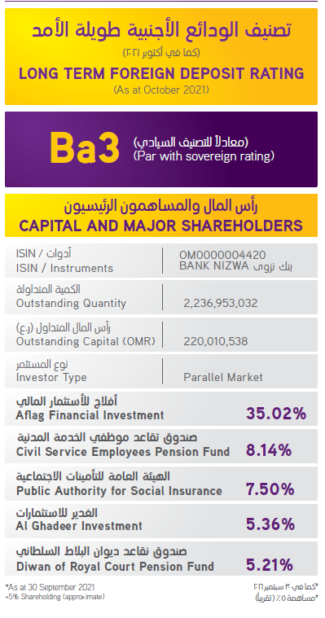
Capital & Major Shareholders

Slide 11
Bank Nizwa Story – A journey of growth
Highest growth in Net Profit
‘Best Islamic Bank in Oman’
IFN Best Banks Poll 2018
Achieved RO 1 Billion mark of Assets
GIFA Championship Award
GIFA Award
Dividends distribution
70 million injection
RO 1.4Billion Assets
First Islamic Bank in
Oman opened officially
Wealth Management
Highest growth rate
First Rating by Moody
Started Operations
5 years strategy
2013
2015
2017
2019
2021
2025
….
2012
2014
2016
2018
2020
2022
License granted
LPO Issued
Completed Major Product offering for Retail and Corporate customers
Commercial Finance
25% customer base
increase
Mobile branch
‘Fastest Growing Bank
in Oman’ at the Banker
Middle East Industry
Awards of 2018
Community Service at the forefront RO 600,000/- contributed to Combat The Impact Of Covid-19
First time Dividends distribution
License granted
LPO Issued
Most Innovative
Islamic Bank -
International
Finance
Magazine
17 branches across the country
RO 1.5 Billion Assets
24% Islamic Banking Market share

Slide 12
Robust Governance Structure
S. No | Board Members | Represents | Audit Committee | Governance, Risk and Compliance Committee | Human Resource Committee | Information Technology Committee | Executive Committee
1 | Sheikh Khalid Abdullah Ali Al Khalili (Chairman) | Aflag Investments |  |  | Committee Member |  | Chairman of the Committee
2 | Mr. Musabah Saif Musabah Al Mutairy (Vice Chairman) | Non-Representative | Committee Member | Chairman of the Committee
3 | Sayyid Amjad Mohammed Ahmed Al Busaidi | Non-Representative |  | Committee Member
4 | Mr. Hussain Yousef Dawood Al Shalwani | Non-Representative | Chairman of the Committee
5 | Sheikh Saif Hilal Nasser Al Mawali | Non-Representative |  | Committee Member | Committee Member
6 | Mr. Majid Ali Majid Al Mamri | Non-Representative |  |  | Chairman of the Committee |  | Committee Member
7 | Mr. Ishaq Zayed Khalifa Al Mawali | PASI |  |  |  | Committee Member | Committee Member
8 | Mr. Saleem Peerbaksh Shahdad Al Raisi | Civil Services Pension Fund | Committee Member |  |  | Committee Member
9 | Mr. Atif Said Rashid Al Siyabi | Non-Representative |  |  |  | Chairman of the Committee | Committee Member

Slide 13
Robust Sharia Governance Structure
S. No | Sharia Members | Sharia Supervisory Board | Sharia Ex-com
1 | Dr. Majid Bin Muhammed Bin Salim Al Kindi | Chairman | Member
2 | Dr. Aznan Hassan | Deputy Chairman
3 | Mr. Ali Sulaiman Mohammed Al Jahdhami | Member | Member

Slide 14
Corporate Governance
Shareholders
Sharia Supervisory Board
Board of Directors
Sharia Executive Committee
Board Audit Committee
Board Governance Risk and Compliance Committee
Board Executive Committee
Board Human Resource Committee
Chief Executive Officer
Audit
Retail
ITSC
ALCO
Finance
Wholesale
MANCOM
Risk Management
CIC
Compliance
IT
Human Resources
Marketing and Corporate Communications
Operations
Legal
Board Information Technology and Cyber Security Committee

Slide 15
Financial Performance

Slide 16
Bank Nizwa Financial Position at a Glance
Key Financials
OMR ('000) | FY17 | FY18 | FY19 | FY 20 | FY 21 | CAGR | Q2 2022
Total Assets | 697,303 | 872,168 | 1,043,364 | 1,205,992 | 1,404,823 | 19.1% | 1,492,876
Total Equity | 130,749 | 137,189 | 147,907 | 159,538 | 239,839 | 16.4% | 237,227
Financing to Customers | 561,210 | 696,470 | 839,303 | 1,030,540 | 1,158,506 | 19.9% | 1,206,846
Customer deposits | 526,150 | 711,275 | 797,166 | 924,208 | 1,109,383 | 20.5% | 1,210,998
Total operating income | 22,392 | 27,098 | 33,018 | 39,254 | 44,348 | 18.6% | 25,022
Tier 1 ratio | 16.31% | 15.40% | 13.75% | 12.78% | 17.85% |  | 15.84%
CAR | 17.25% | 16.24% | 14.46% | 13.68% | 18.78% |  | 16.64%
NPL ratio | - | 1.00% | 0.08% | 1.30% | 1.18% |  | 1.65%
ROA | 0.62% | 0.96% | 1.06% | 0.98% | 0.96% |  | 1.07%
ROE | 2.94% | 5.61% | 6.90% | 7.20% | 6.27% |  | 6.5%
NPA: 1.65%
ROA: 1.07% (F)
ROE: 6.5% (F)
CAR: 16.64%
Tier 1: 15.84%

Slide 17
Prudent Balance Sheet Management
Assets grew 16.49% Y/Y, Financing grew by 12.4%, Deposits grew by 20.04%
CAGR 19%
CAGR 16%
CAGR 20%
CAGR 20.5%
OMR ('000) | FY17 | FY18 | FY19 | FY 20 | FY 21 | CAGR | Q2 2022
Total Assets | 697,303 | 872,168 | 1,043,364 | 1,205,992 | 1,404,823 | 19.1% | 1,492,876
Total Equity | 130,749 | 137,189 | 147,907 | 159,538 | 239,839 | 16.4% | 237,227
Financing to Customers | 561,210 | 696,470 | 839,303 | 1,030,540 | 1,158,506 | 19.9% | 1,206,846
Customer deposits | 526,150 | 711,275 | 797,166 | 924,208 | 1,109,383 | 20.5% | 1,210,998

Slide 18
NPAT up by 13% Y/Y whereas CAGR 34.86% in 4 Yrs.
Income growth, with operating expense in check, strong operating performance, with lower cost of risk
CAGR 18.6%
CAGR 8.6%
CAGR 37.7%
CAGR 34.86%
 | FY17 | FY18 | FY19 | FY 20 | FY 21 | CAGR
Operating Income | 22,392 | 27,098 | 33,018 | 39,254 | 44,348 | 18.63%
Operating Expense | 16,420 | 16,658 | 18,430 | 19,656 | 22,875 | 8.64%
Pre- Provision Profit | 5,972 | 10,440 | 14,588 | 19,598 | 21,473 | 37.70%
Cash NPAT | 3,787 | 7,512 | 10,179 | 11,067 | 12,526 | 34.86%

Slide 19
Strategy 2025

Slide 20
Our Strength
Our People
Disciplined Credit and Investment Decision
Segment Focused Business
Solid Capital Base

Slide 21
Our High 5 Strategy
Gain Market Share and Solidify Leadership position
Financial Performance
Technological Advancement
Sustainable Future
Progressive Organization

Slide 22
Stakeholders Focused Strategy
Stakeholders
Customers
Shareholders
Regulator
Tailored Products
Competitive Pricing
Efficient Processing
Accessible
Better and Sustainable Returns
Growth in shareholders’ wealth
Corporate Governance and Compliance
Employees
Prudent Management of Assets to support Growth
Train and develop Omanis
More opportunities for Women
Health and Safety
Competitive Work Environment
Compliance to the regulations
Continuous engagement with regulator
More active role in addressing industry challenges to support economy

Slide 23
Growth in Key Financial Metrics
Assets | Market Share | Investors’ Wealth
Assets Growth
Revenue Growth
Shareholders Wealth Increase
13%
12%
7%
12% growth in financing; 16 growth in deposits.
scale up our business at given return levels and to increase our profits substantially.
Improve all financial performance metrics.
Improve profitability margins to provide continuous support for operating growth
New dividend policy will secure gradual growth of return on capital to our shareholders in the form of dividends
Disclaimer: This is not an investment advice. Investment in Bank Nizwa SAOG stocks is subject to market risk. Investors are advised to do proper due diligence before making any investment decisions.

Slide 24
Capital Overview
Dividend policy is aimed at achieving an optimum balance between the current interests of investors and the long-term goals
Balanced risk-adjusted performance across business areas and units;
continue to take risk-reward phenomenon in all business decision;
Prudent management of balance sheet to derive return on capital; and
Maintain desired level of buffers over minimum regulatory requirements.

Slide 25
Asset Quality
Maintain high assets quality, diversify portfolio to a resilient sector;
Prudent Credit and Investments approach;
Balanced approach of keeping short-term assets, government sectors, medium-size corporate, SMEs, Public Private Partnerships and Govt. preferred sectors as area of focus;
Grow domestic Islamic finance market; and
Maintain credit discipline across businesses.

Slide 26
Profitability and Operating Performance
Continue improving margins through sustainable business;
Diversify income streams through product, clients and segment;
Keep cost-to-income ratio in check; and
Drive performance through continuous monitoring

Slide 27
Funding and Liquidity
Balanced risk-adjusted performance across business areas and units;
High-risk management standards with a focus on risk concentrations;
Compliance with regulatory requirements;
Substantial capital and liquidity position; and
Stable funding and liquidity strategy allowing for business planning within the liquidity risk appetite and regulatory requirements.
Funding Components | Q2-2022 | Q2-2021 | % of Total | % YoY
Inter-bank Wakala | 11,550 | 74,601 | 1.29% | -84.50%
Customer Deposits | 1,210,999 | 1,048,337 | 68.70% | 34.20%
Other liabilities | 31,711 | 34,326 | 3.54% | -7.60%
Owners' Equity | 237,226 | 164,166 | 26.47% | 44.50%

Slide 28
Business Overview

Slide 29
Business Segments Performance and Strategies
Public Private Partnership
Oman 2040 priority sector as area of focus
Sukuks, Advisory, Sustainable Finance
Growing demand for sukuks, Islamic finance, project finance, Musharaka finance, Istisna, Trade finance will drive the overall business
Deposit mobilization
Wealth Management
Mass Market banking
New Savings Product
Digital Footprint
Service Excellence through digitalization
Continue to gain market share through direct client acquisition strategy
Interbank activities is set to increase with a new Sukuks instruments, new issuance of sukuks in OMR and USD will drive healthy activities.
Non-fund business with the growing economic activity will support the non-fund business.
International Banking, Trade Finance business will continue to drive FX business

Slide 30
Outlook for H2-2022

Slide 31
Oman Economic and Banking Outlook
Sector remain resilient
Well capitalized
Cost of risk will start to moderate
Tanfeedh and Tawazun led program, should underpin growth in coming years.
Credit off-take is set to improve with the GDP
Government initiatives and projects will help creating demand for credit
Consumer demand will improve with the recovery
Strong confidence of foreign investment on Govt. related issues and rising oil prices will support Govt. budget needs
Local demand for Govt. Sukuks and good rate sukuk will pickup the momentum
Public-Private Partnership will drive the Sector Growth

Slide 32
Thank you for your attention
Investorsrelation@banknizwa.om

